Slide 1

Hotel Review Data Analysis
Mentor- Iftekar Patel
Group-4
Sinduja T
Rugved Chaudhari
Azim Khan
Neeraj Kumar N.M
Krishna Nayak
Vaibhavi Jagtap

Slide 2

Business Problem
Project Flow
Data Summary
EDA
Data Pre-processing
Data Visulization
Different Model Performance
Deployment
Conclusion

Slide 3
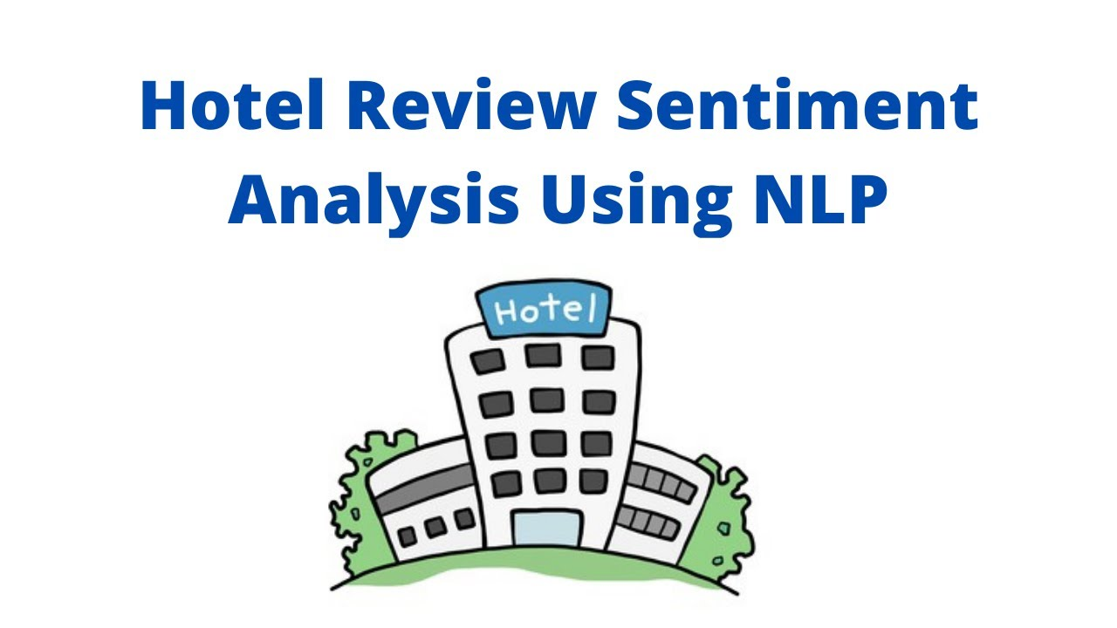

Objective:
Our goal is to examine how travellers are communicating their positive and negative experiences in online platforms for staying in a specific hotel and major objective is what are the attributes that travellers are considering while selecting a hotel. With this manager can understand which elements of their hotel influence more in forming a positive review or improves hotel brand image.

Slide 4


Introduction:
Customer reviews on hotels are very important part of travel plan for people now a days.
It can be said that customer reviews plays an important part for business owners in order to improve their services.
In this project, sentiment analysis is performed on the basis of user reviews using four diﬀerent classiﬁers.
The classiﬁers used in this project are “Logistic Regression”, “Naive Bayes”, “Random Forest” and “Support Vector Machine”.
The performance of these algorithms are assessed on three diﬀerent parameter settings. The reviews are classiﬁed as “positive”, “neutral”, and “negative” labels.

Slide 5
Project Flow
Data Input
Data Pre-processing
Exploratory Data Analysis
Training Various Models
Predicting Results and Selecting Best Model
Analysis and Conclusion
Deployment
RESULT

Slide 6
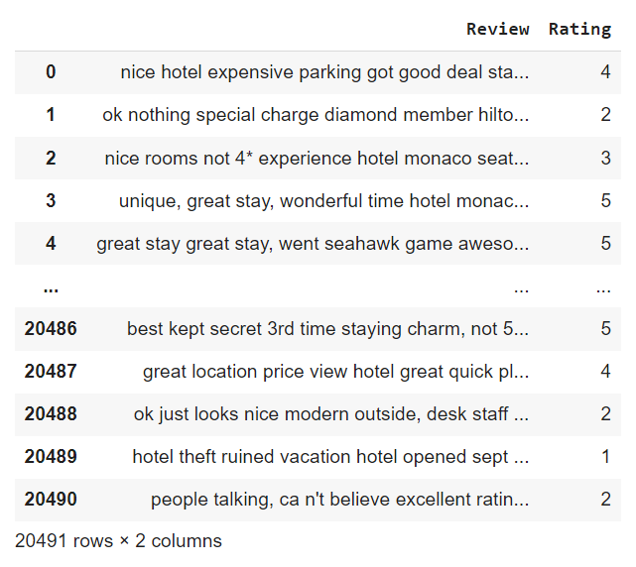
Data Description:
Dataset details:
The above dataset containing hotel reviews provided by client.
The Dataset contains 20,491 rows and 2 columns.
The Dataset does not have duplicate or missing values.

Slide 7
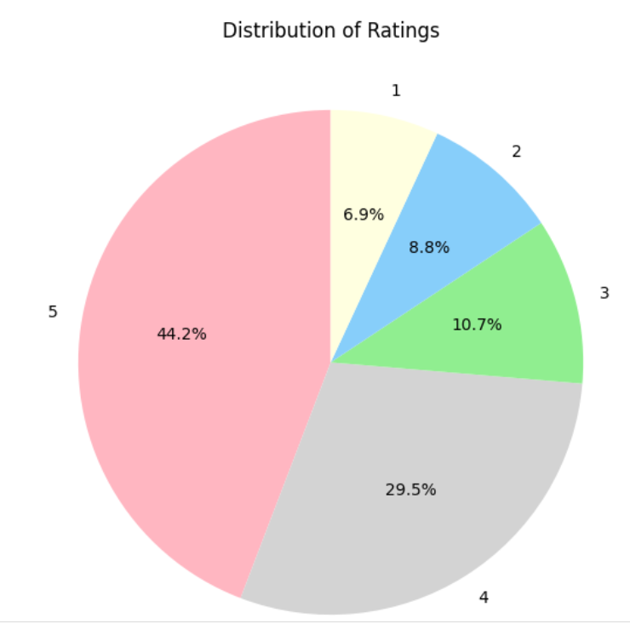
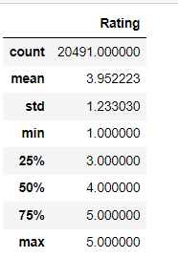
Exploratory Data Analysis
Here as we see 4 and 5 rating are contributing nearly 75% which shows biased towards positive side.

Slide 8
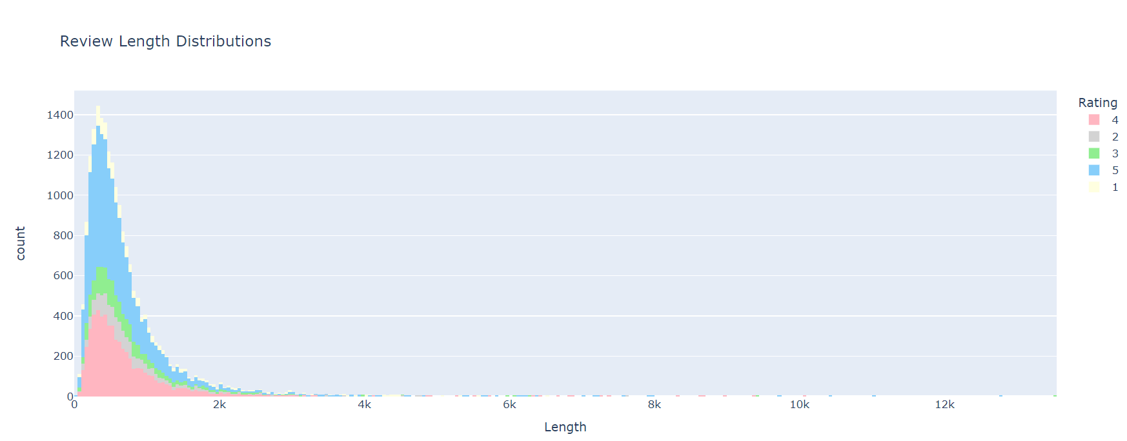
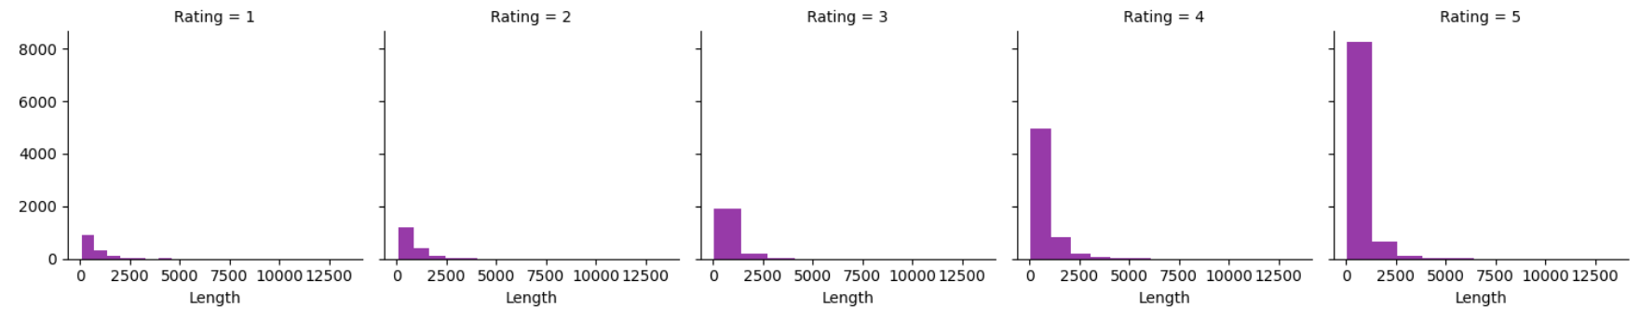

Slide 9
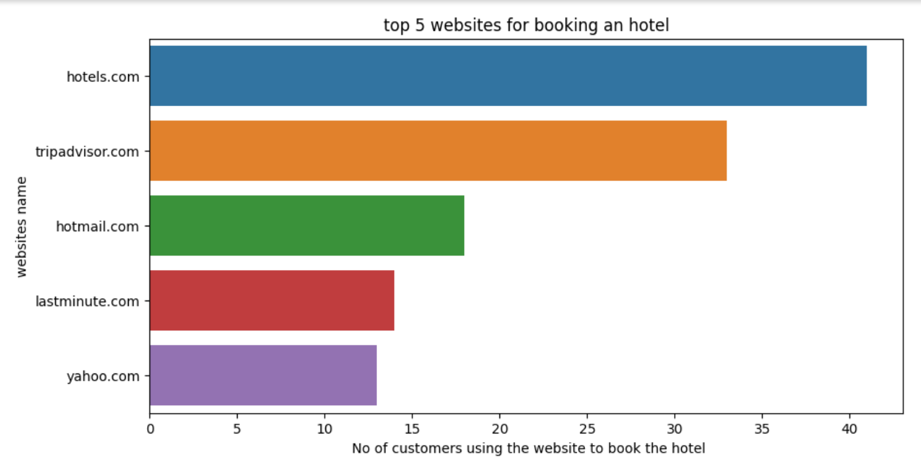
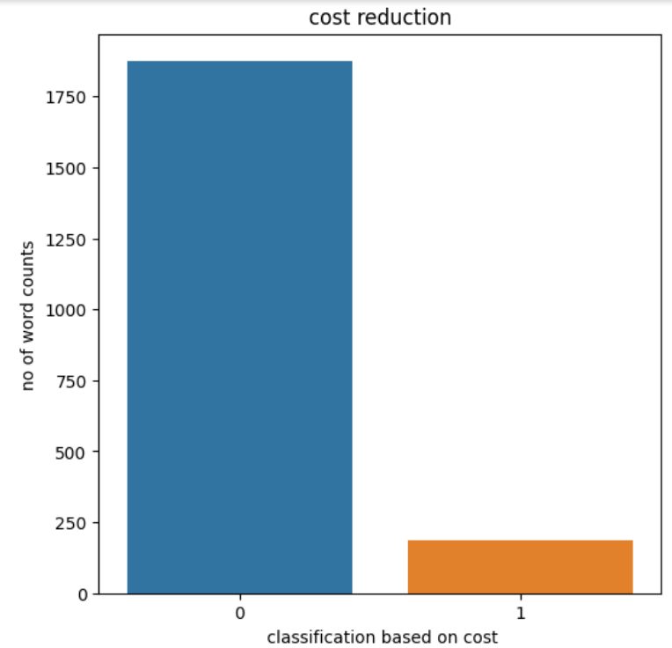
This Graph shows top websites preferred by costumers to book hotel online
Word count for expensive and Affordable indicates major concern towards hotel costing

Slide 10
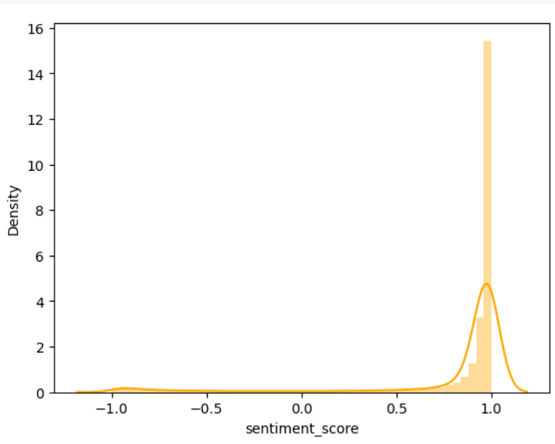
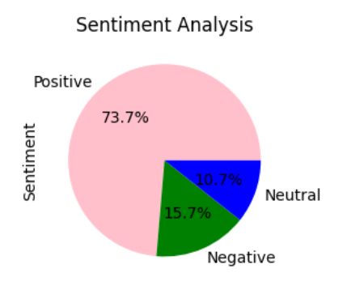
Sentiment Analysis
In this plot, we plot the Sentiment Score for different sentiment.
From above graph we can conclude our dataset is biased towards positive side and positive sentiment percentage is 73.7%,negative sentiment percentage is 15.7% and for neutral sentiment is 10.7%.

Slide 11
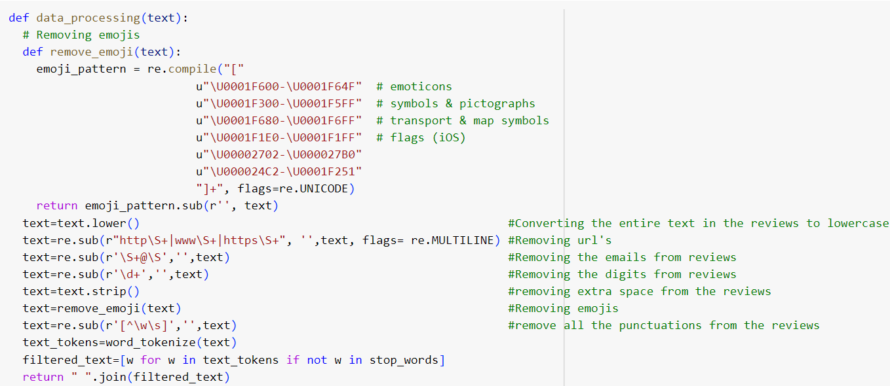
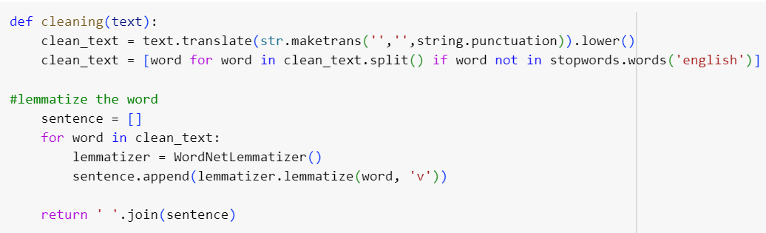
Data Preprocessing:
STEPS FOR DATA CLEANING
Lower Case Conversion
Remove links,
emails, digits, extra space
and emojis.
3. Remove Punctuation
4. Tokenization
Removing stop words
Lemmatization
Data Preprocessing:
Data Preprocessing is done to make the data into a usable format and the clean data is used to train the model.
we will use Lemmatization in order to get the base form of the word.

Slide 12
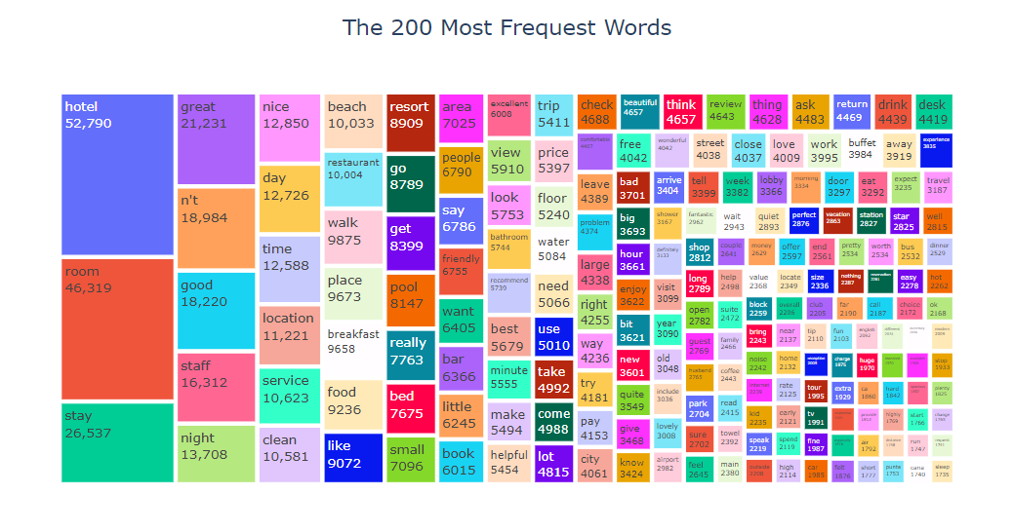
Data Visulization:
Based on the Tree map above, all of the words are most frequently occurring words. we are dealing with a hotel review dataset to classify the reviews with respect to ratings.

Slide 13
Label Encoder
Label encoding is a technique used in machine learning and data analysis to convert categorical variables into numerical format. It is particularly useful when working with algorithms that require numerical input, as most machine learning models can only operate on numerical data.
Sentiment | Labels
Negative | 0
Neutral | 1
Positive | 2

Slide 14
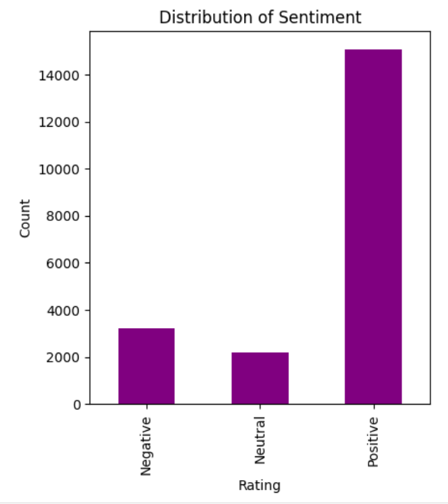
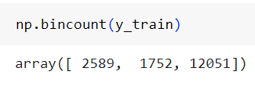
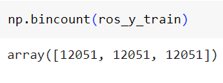
Handling Imbalanced Data
There are different methods to handling imbalanced dataset:
1.SMOTE
2. Resampling (Oversampling and Undersampling)
3. Ensemble Technique
Imbalanced Data
Balanced Data

Slide 15
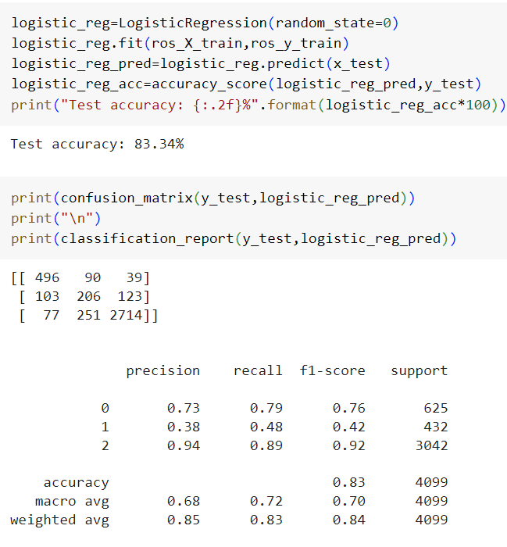
Model Building
Classification Report:
Logistic Regression
A statistical method that is used for building machine learning models where the dependent variable is dichotomous: i.e. binary. Logistic regression is used to describe data and the relationship between one dependent variable and one or more independent variables

Slide 16
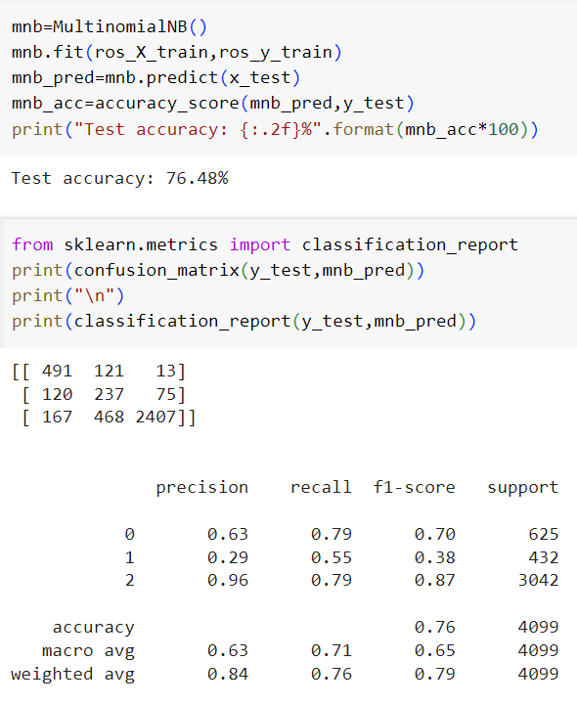
Classification Report:
Naive Bayes
Naïve Bayes is a simple learning algorithm that utilizes Bayes rule together with a strong assumption that the attributes are conditionally independent, given the class. While this independence assumption is often violated in practice, naïve Bayes nonetheless often delivers competitive classification accuracy.

Slide 17
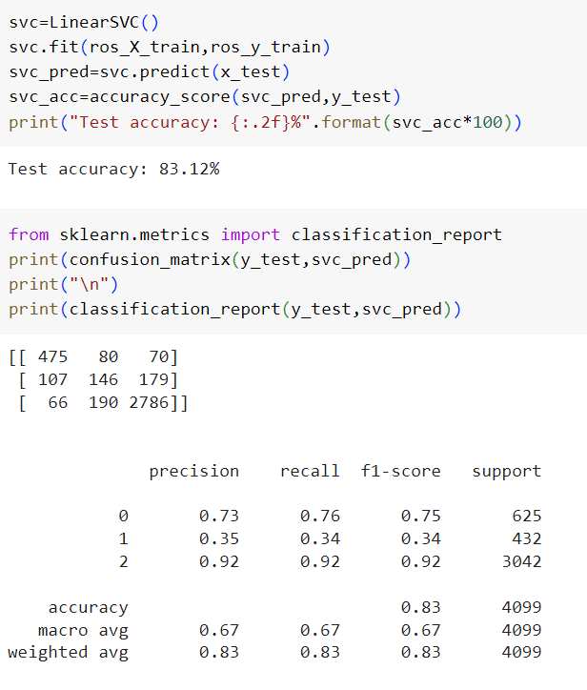
Classification Report:
SVC(Support Vector Classifier)
SVC, or Support Vector Classifier, is a supervised machine learning algorithm typically used for classification tasks. SVC works by mapping data points to a high-dimensional space and then finding the optimal hyperplane that divides the data into two classes.

Slide 18
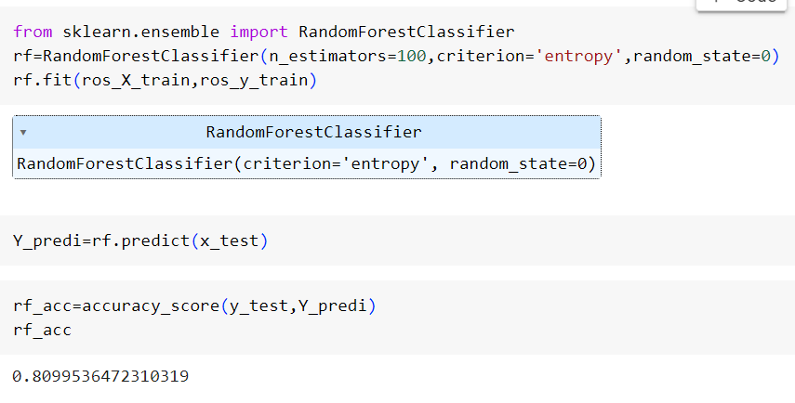
Classification Report:
Random Forest Classifier
Random forest is an ensemble method which creates a number of decision trees turned into an ensembled forest. Since random forest is an ensemble method, it randomly selects features to be used in each step for training while forming the decision trees.

Slide 19
Result
Term Frequency with TFIDF
Term Frequency-Inverse Document Frequency
In this Case, Term Frequency Inverse Document Frequency (TF-IDF) performed better than the word count vectorization method.
The best accuracy score for positive sentiment was 92% with a SVC For negative sentiment, the higher accuracy score was 76% with a SVC and for neutral, the best performance with 34% of accuracy rate.
Observations:
Sentiment | Logistic Regression |  |  | Naïve Bayes |  |  | SVC
 | Precision | Recall | f1-Score | Precision | Recall | f1-Score | Precision | Recall | f1-Score
Negative-0 | 0.73 | 0.79 | 0.76 | 0.63 | 0.79 | 0.70 | 0.73 | 0.76 | 0.75
Neutral-1 | 0.38 | 0.48 | 0.48 | 0.29 | 0.55 | 0.38 | 0.35 | 0.34 | 0.34
Positive-2 | 0.94 | 0.89 | 0.89 | 0.96 | 0.79 | 0.87 | 0.92 | 0.92 | 0.92

Slide 20
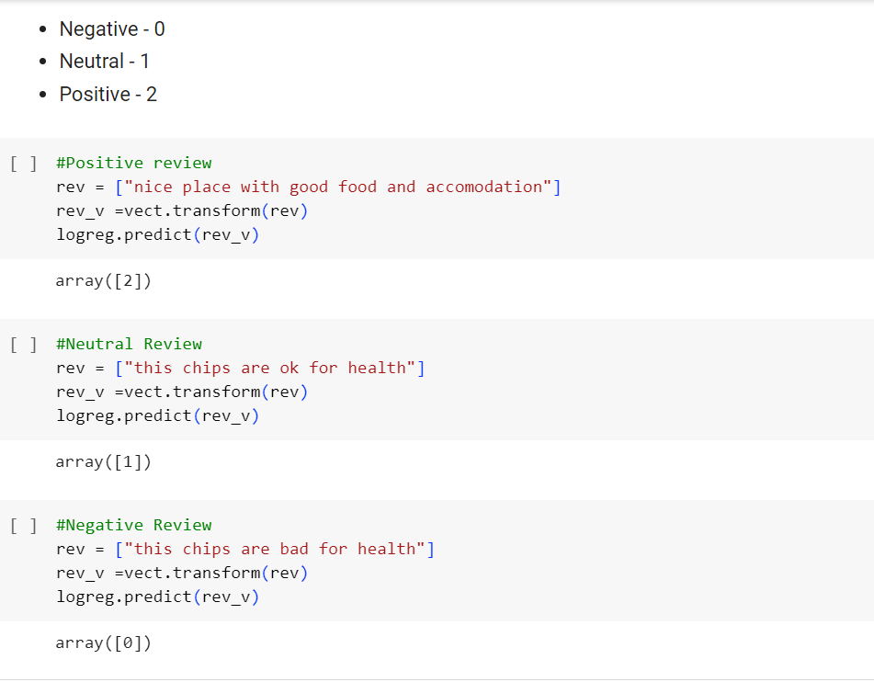
Prediction on Review

Slide 21
Deployment
https://ml-web-app-aprf3sqylwqnjqhbhhgufi.streamlit.app/

Slide 22
Conclusion
Employing Support Vector Classifier for Hotel Rating classification proves to be an effective and accurate method.
The model demonstrates robust performance in categorizing hotels based on various features, providing a reliable tool for assessing and comparing accommodations. With its ability to predict ratings with precision,
Logistic Regression enhances decision-making processes in the hospitality industry, contributing to improved customer experiences and informed choices for travelers.

Slide 23
THANK YOU

